Slide 1
TEXT TO BRAILLE CONVERTING COMMUNICATION DEVICE FOR THE VISUAL AND HEARING IMPAIRED PERSONS

Slide 2
ABSTRACT
The main objective of this project is to provide a complete solution to different communication problem in the visually impaired person’s lives. In mainly we are facing India is now a home to the world's largest number of blind people.
Technologies are developed day by day principally in communication through mobile phones which plays a crucial role. In message application the visually impaired people only can able to read the message in on the tactile surface of the display. But the quality of the system is not good because the blind people not able to identify the text clearly. Still now Braille technology is used by the blinds only for the reading purpose. In our Method using this Braille system both reading and replying the messages possible by visually impaired people.
In this system using Braille technology the blind people can access the message android application in mobiles as a normal people. At the same time keypad using one by one messages will be sending in the based on the keypad options by user can easily send the information's through Message .We are Using this system uneducated people also may use the message application in mobiles and then Easily Blind People Message getting via Bluetooth for mobile service communication.

Slide 3
EXISTING SYSTEM
Existing System is an includes a smart glove that translates the Braille alphabet, which is used almost universally by the literate deaf blind population, into text and vice versa, The wearer can perceive and interpret incoming messages by tactile feedback patterns of mini vibrational motors on the dorsal side of the glove.
The successful implementation of real-time two- way translation between English and Braille, and communication of the wearable device with a mobile phone/PC opens up new opportunities of information exchange which were hitherto un- available to deaf blind individuals, such as remote communication, as well as parallel one-to many broadcast.
The glove also makes communicating with laypersons without knowledge of Braille possible, without the need for trained interpreters. A Braille writer through which the deaf blind and the blind persons can write the Braille script.

Slide 4
DISADVANTAGES
Requirements Of High-Voltage Supplies.
High Price.
Low Flexibility.
Low Accuracy

Slide 5
PROPOSED SYSTEM
The Proposed System help the blind people to communicates the message via mobile android application. It enables user to convey simple messages by capacitive touch sensors as input sensors placed on the Palmer side of the Message converted to text by the mobile phone.
But here, using this Braille system both reading and replying the messages possible by visually impaired people. This system helps the blind people can access the message application in mobiles as a normal people.
At the same time, the keypad is used to send one by one message based on keypad options so the user can send the information through messages easily. This system is also applicable for uneducated people.

Slide 6
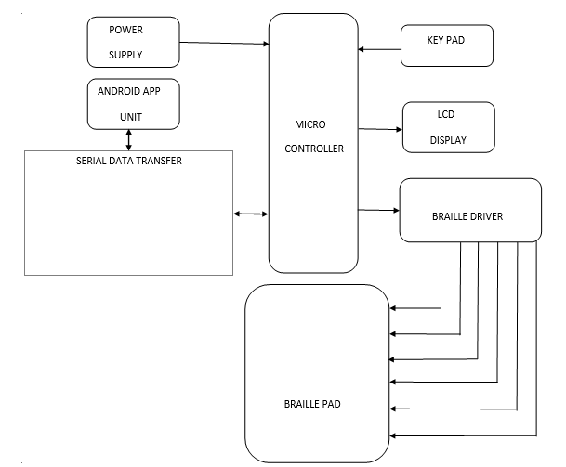
BLOCK DIAGRAM

Slide 7
Power Supply
Every electrical and electronic device that we use in our day-to-day life will require a power supply. In general, we use an AC supply of 230V 50Hz, but this power has to be changed into the required form with required values or voltage range.
The step-down converters are used for converting the high voltage into low voltage. 230V AC is converted into 12V AC.
The bridge rectifier is frequently used for converting AC to DC.
This pulsating DC can be filtered using a capacitor filter for removing the ripples.
voltage regulator IC7805 is used to stepped down 12V DC to 5V DC.

Slide 8
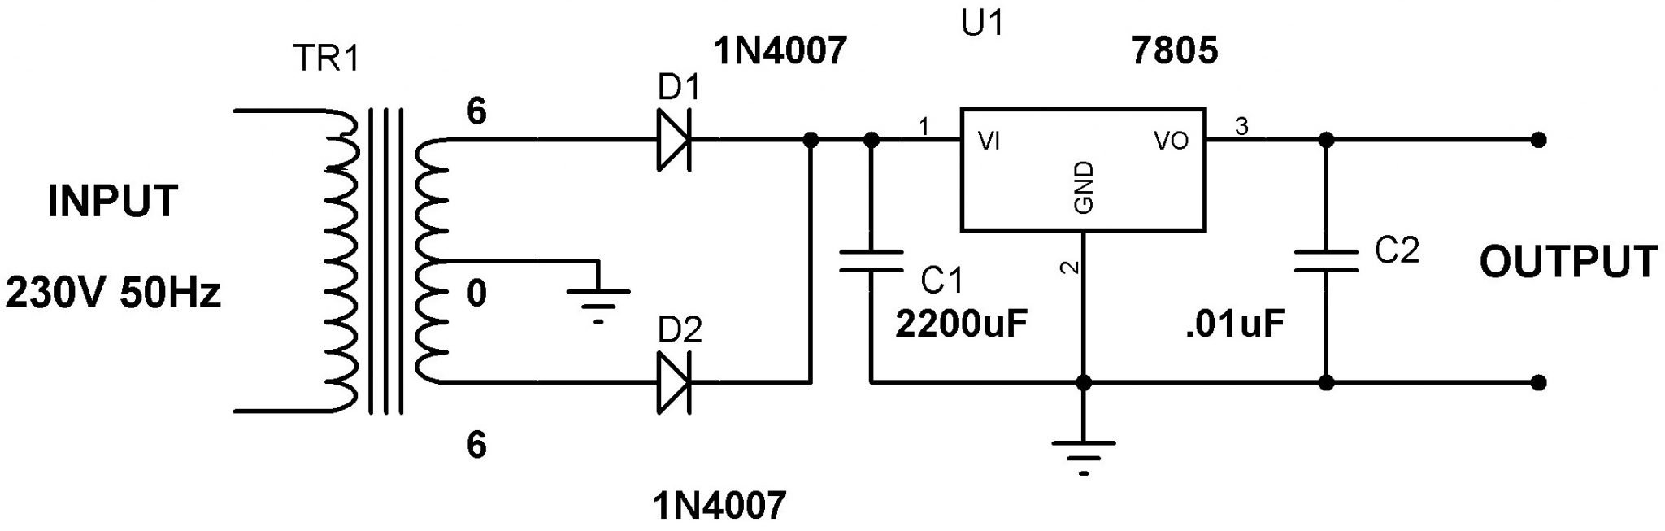

Slide 9
Atmega328
The high-performance Microchip 8-bit AVR RISC-based microcontroller
32KB ISP flash memory with read-while-write capabilities
1KB EEPROM
2KB SRAM
23 general purpose I/O lines
32 general purpose working registers
three flexible timer/counters
6-channel 10-bit A/D

Slide 10
Relay
A relay is an electrically operated switch.
Many relays use an electromagnet to mechanically operate a switch, but other operating principles are also used, such as solid-state relays.
Relays are used where it is necessary to control a circuit by a separate low-power signal, or where several circuits must be controlled by one signal.
Relays were used extensively in telephone exchanges and early computers to perform logical operations.

Slide 11
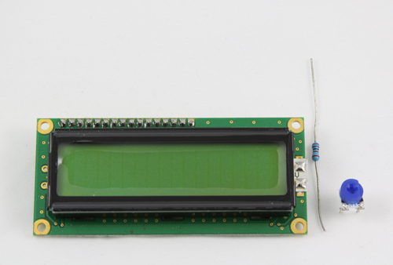
LCD
A liquid-crystal display (LCD) is a flat panel display, electronic visual display, or video display that uses the light modulating properties of liquid crystals. Liquid crystals do not emit light directly.
LCDs are available to display arbitrary images (as in a general-purpose computer display) or fixed images which can be displayed or hidden, such as preset words, digits, and 7-segment displays as in a digital clock.
LCDs are used in a wide range of applications including computer monitors, televisions, instrument panels, aircraft cockpit displays.

Slide 12
ADVANTAGES
Low Cost.
Portable.
Small Size.
Easy Access.

Slide 13
HARDWARE REQUIREMENTS
MICRO CONTROLLER
LCD DISPLAY
KEY PAD
SERIAL DATA TRANSFER
BRAILLE DRIVER
BRAILLE PAD
BRAILLE MOTORS (6 )
BLUETOOTH

Slide 14
SOFTWARE REQUIREMENTS
EMBEDDED C
ARDUINO IDE
ANDRIOD APP

Slide 15
Future enhancement
The telecommunication technology has become the integrated part of our day today life. It has completely revolutionaries the way we communicate, especially long distance communication. Despite of all these advancement in the telecommunication field, the physically impaired people have no access for these technologies. So as a step to bridge the gap between the blind people and the technological advancement in the telecommunication field in future to design a SMS system for them by interfacing Braille pad with the cell phone so that dual impaired person can have the access to the SMS system. Here the user sends the SMS to the blind person’s mobile number which is connected to the microcontroller which reads the SMS using GSM module through the AT commands and then converts the letters of the SMS into the Braille language using the lookup table in its memory

